Slide 1


FOOD ORDERING WEBSITE
NEHA(201500435)
SHIPRA AGRAWAL(201500648)
SHIVAM DUBEY(201500651)

Slide 2
CONTENT Introduction Problem Statement Objective Functionalities Screenshots Conclusion

Slide 3
INTRODUCTION The food ordering website is an online platform that allows customers to order food from different restaurants and have it delivered to their doorstep. The website includes a login/register page for customers to create an account or log in with their existing credentials. Customers can browse and search for different dishes, add them to the cart, and see the total cost of their order, which is automatically updated as they add or remove items from their cart.

Slide 4
PROBLEM STATEMENT The online food ordering system sets up a food menu online and customers can easily place the order as per they like. Also, the online customers can easily track their orders.

Slide 5
OBJECTIVE The objective of a food ordering website is to provide a platform for customers to easily browse menus, place orders, and make payments. The website should offer a wide variety of food choices and allow customers to customize their orders.

Slide 6
FUNCTIONALITIES
Menu Display: The website displays the restaurant's menu in an easy-to-browse format, often with pictures and descriptions of each dish.
Search and Filter: Customers can search for specific dishes or filter the menu by dietary requirements or preferences

Slide 7
Order Placement: Customers can select the dishes they want to order and add them to their cart.
Payment Processing: Customers can securely enter their payment information and complete the transaction through the website.
Customer Reviews: The website displays customer reviews and ratings for each restaurant, helping customers make informed decisions.

Slide 8
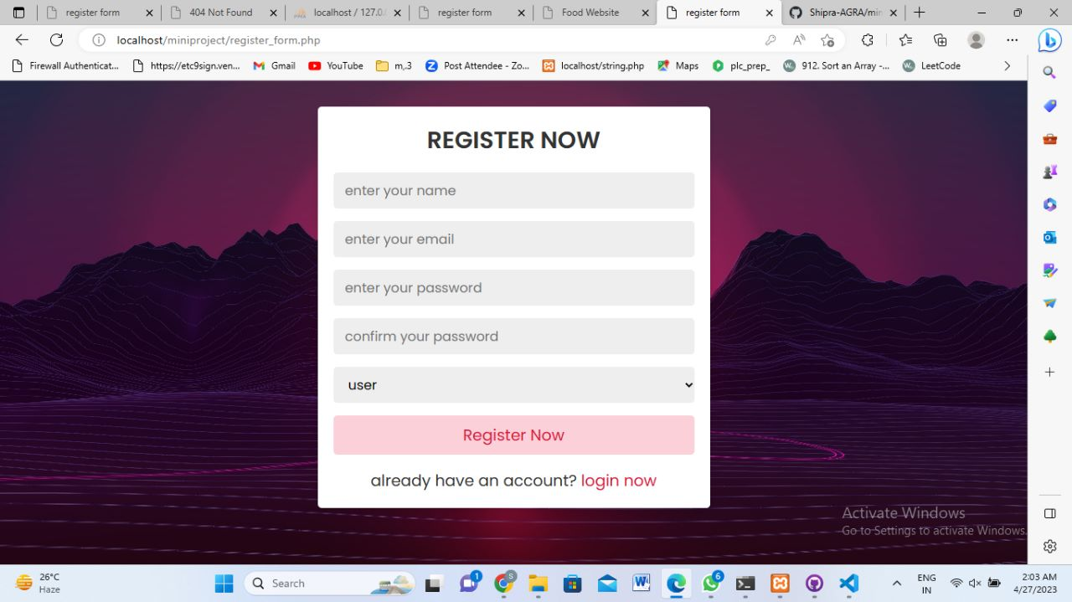
Screenshots

Slide 9
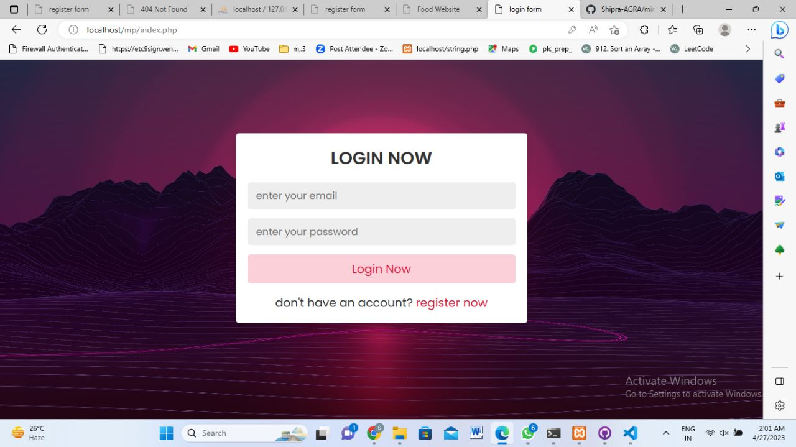

Slide 10
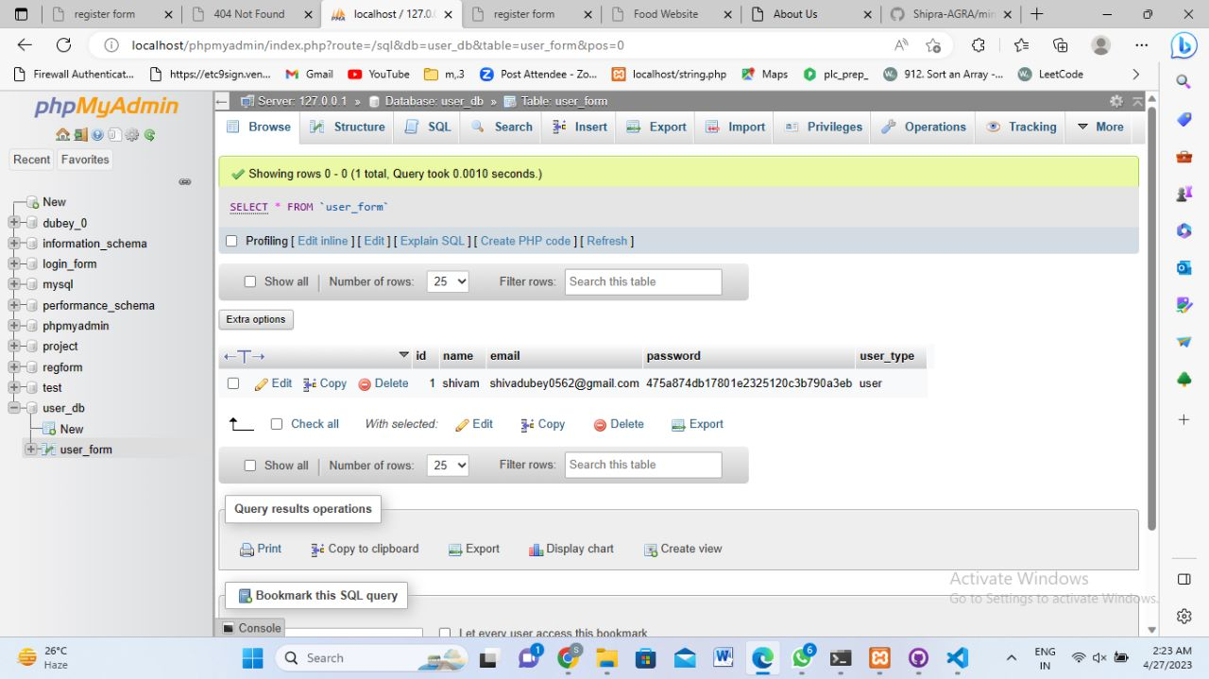

Slide 11
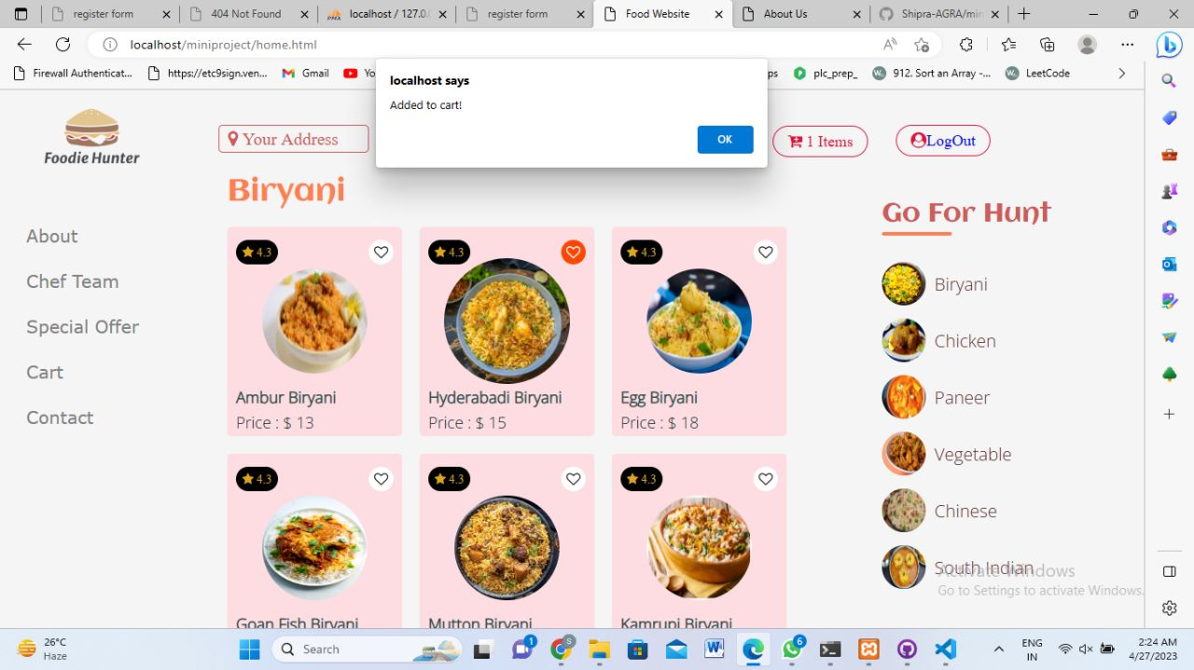

Slide 12
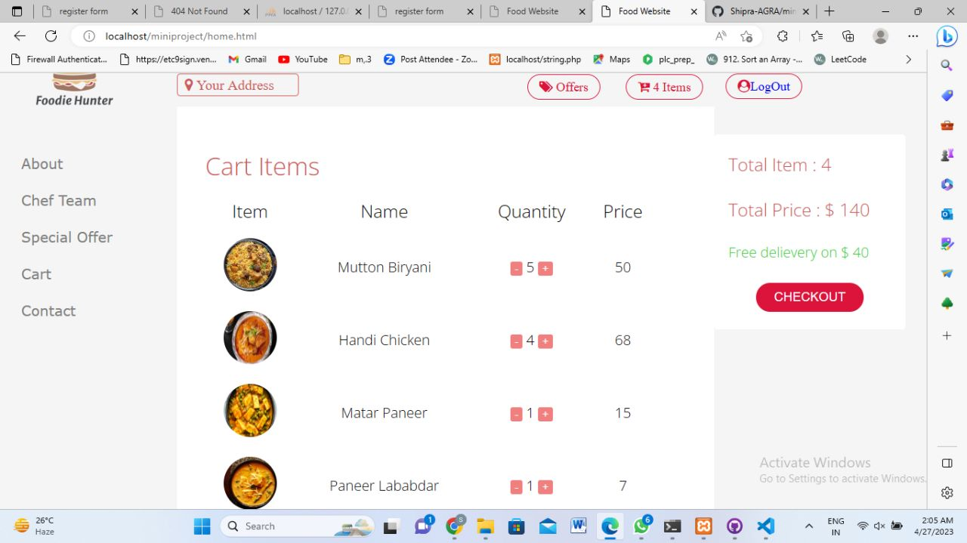

Slide 13
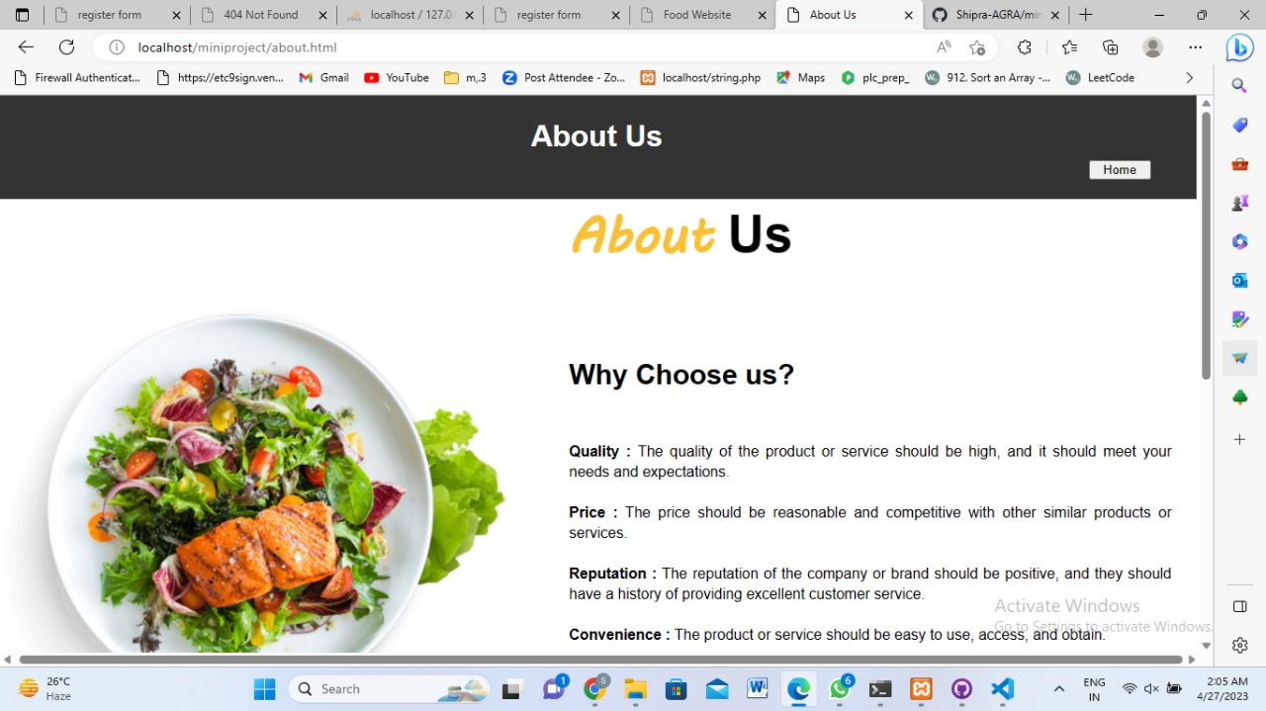

Slide 14
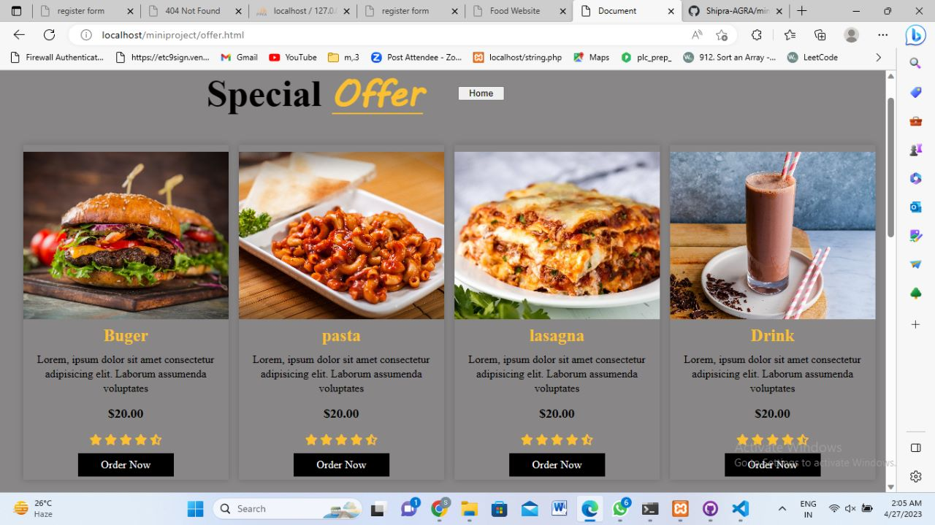

Slide 15
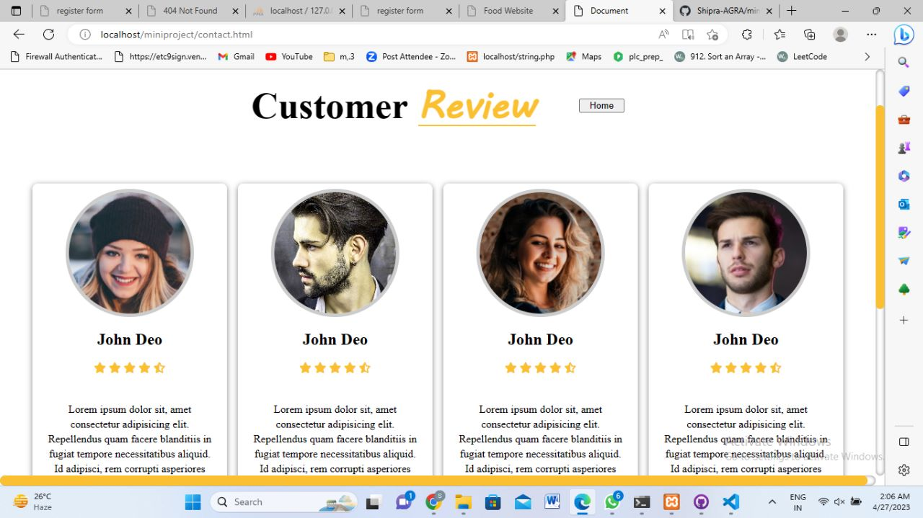

Slide 16
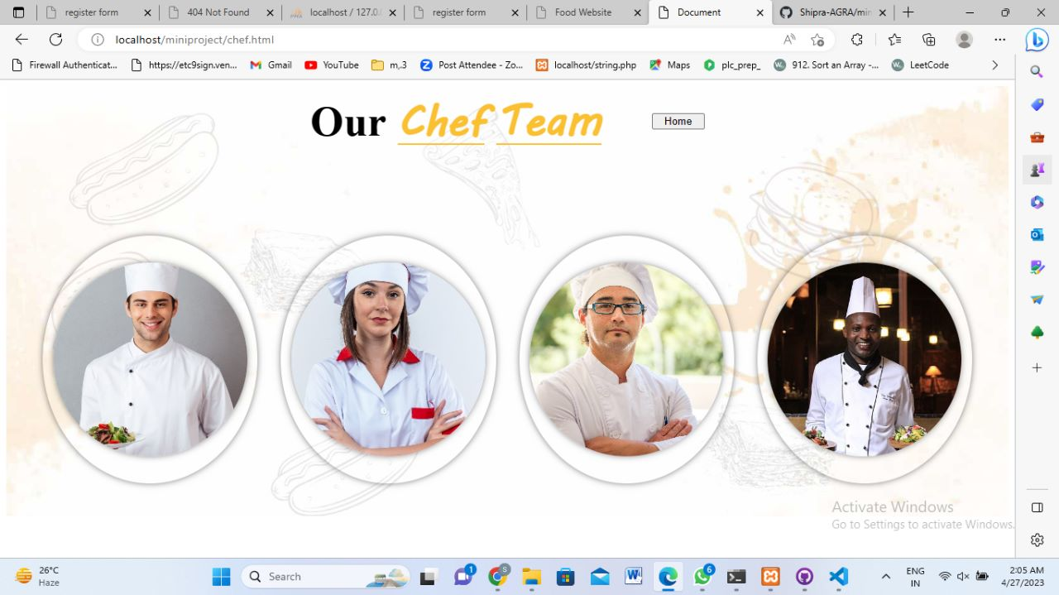

Slide 17
CONCLUSION
Convenience: Food ordering websites provide convenience to customers by allowing them to order food from the comfort of their homes or offices.
Wide variety of choices: Food ordering websites provide a wide variety of food choices to customers. This allows customers to easily browse through the menu and select the dishes they want to order.

Slide 18
Time-saving: By ordering food online, customers can save time that they would have spent traveling to the restaurant, waiting in line to order, and waiting for the food to be prepared. Efficient delivery: Food ordering websites have streamlined delivery systems that ensure that food is delivered to the customer's doorstep in a timely and efficient manner.

Slide 19
THANKYOU

